Slide 1

Finite Automata
Dr. Rajnish Chaturvedi

Slide 2
Finite Automata
Finite Automata: It is a mathematical model that works for several computer algorithms. It is called finite because it works on Finite set of Input symbols with Finite number of States and gives output in finite times.
Magnetic tape
a
b
b
a
b
a
a
Reading Head
Output
Finite Control

Slide 3
Applications of Automata
Applications of Finite Automata
String Matching
Lexical Analysis
Design and Analysis of Digital Circuits
Finite automata is another method for defining languages.
It’s a Graphical Method.

Slide 4
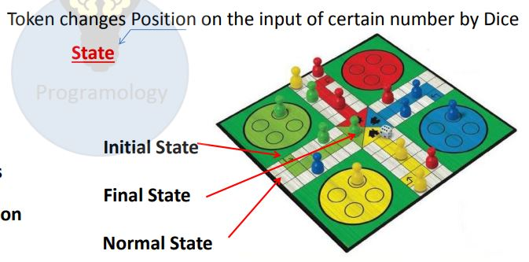
Finite Automata

Slide 5
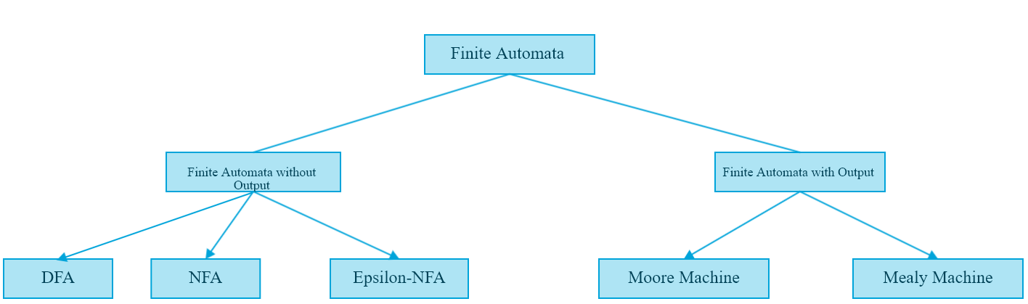
Finite Automata

Slide 6
Deterministic Finite Automata
Formal Definition of DFA
A DFA is a collection of 5-tuples same as we described in the definition of FA.
Q: finite set of states
∑: finite set of the input symbol
q0: initial state
F: final state
δ: Transition function
Transition function can be defined as:
δ: Q x ∑→Q

Slide 7
DFA (Deterministic Finite Automata)
For a DFA the machine moves to a particular unique state from a given state and given input that is why it is called Deterministic. As the number of states in DFA are Finite it is called Deterministic Finite Automata.
Next State is known ( Has only one next state for an input)
q1
a
q0
b
q2

Slide 8
DFA
Representation of δ
Transition Diagram
Transition Table
Transition Function

Slide 9
DFA
Transition Diagram
M={ {q0, q1, q2}, {0,1}, δ, q0, q2}
0
0
1
0
q0
q1
q2
1
1

Slide 10
DFA
Transition Table
Present State | Next State
 | 0 | 1
→ q0 | q0 | q1
q1 | q0 | q2
*q2 | q0 | q0

Slide 11
DFA
Transition Function
δ(q₀, 0)= q₀
δ(q₀, 1)= q₁
δ(q₁, 0)= q₂
δ(q₁, 1)= q₀
δ(q₂, 0)= q₁
δ(q₂, 1)= q₂

Slide 12
Language of a DFA
The language of a DFA M=(Q, Σ, δ, q₀, F) is the set of all strings over Σ accepted by M i.e. L(M) and is denoted
L(M) = {w | w ∈ Σ∗ , δ(q_{0 ,} w) = q_{f} where q_{f} ∈ F}
f
M:
off
on
f
Language of M is {f, fff, fffff, …} = {f ^{n}: n is odd}

Slide 13

Example of DFA
DFA with ∑ = {0, 1} accepts all ending with 0.

Slide 14
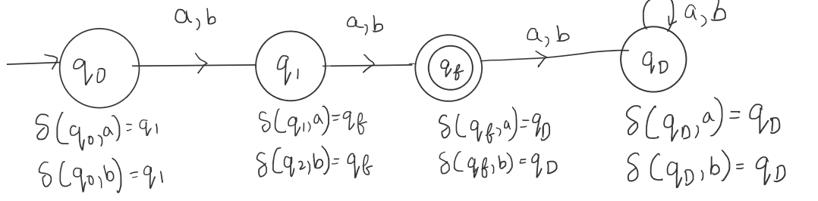
Question 1-
Construct a DFA, that accepts the set of all strings over {a,b} of length 2.

Slide 15
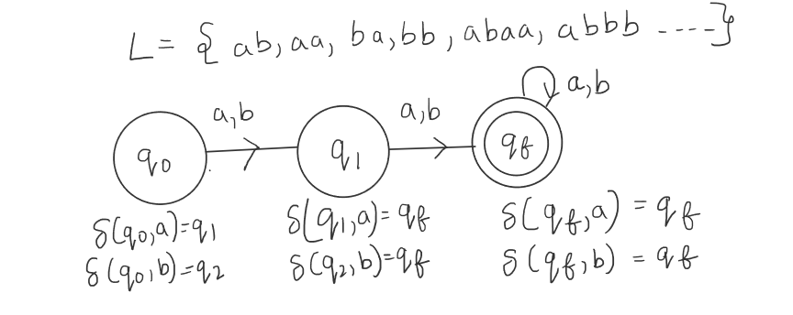
Question 2-
Construct a DFA, that accepts the set of all strings over {a,b} of length greater than and equal to 2.
OR
Construct a DFA, w€{a,b} and |w|>=2

Slide 16
Example
0
0
1
The set of all string over {0,1} containing even no. of 1’s
q₀
q₁
1
0
1
The set of all string over {0,1} ending with 1’s
1
q₀
q₁
0
0
1
0,1
The set of all string over {0,1} does not contain 10 as substring
q₀
1
q₁
0
q₂

Slide 17

Question 3-
Construct a DFA, that accepts the set of all strings over {a,b} of length less than and equal to 2.
OR
Construct a DFA, w€{a,b} and |w|<=2.

Slide 18

Question 4-
Construct a Minimal DFA, that accepts the set of all strings over {a,b} of length of each string is even.
OR
Construct a DFA, w€{a,b} and |w|mod 2=0.

Slide 19

Question 5-
Construct a Minimal DFA, that accepts the set of all strings over {a,b} of length of each string is odd.
OR
Construct a DFA, w€{a,b} and |w|mod 2=1.

Slide 20
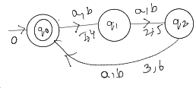
Question 6-
Construct a DFA, w€{a,b} and |w|mod 3=0.

Slide 21
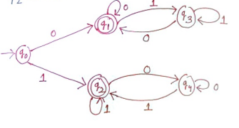

Slide 22

